Slide 1

Hotel Demand Analysis
IKBAL YESILTAS | 21/02/2020

Slide 2
Overview
Context
Dataset
Analysis
Tailoring Experience
Decrease Cancellation Rate
Increase Average Rates
Recommendation

Slide 3

Context
A city hotel wants us to help in their revenue management and increase their overall performance. They provide a dataset containing all bookings made from 2015 to 2017.

Slide 4
Dataset
The Dataset consists of booking information such as
Number of adults, children, babies
Cancellations
Lead Time in days
Average Daily Rates
Arrival and Depart times
Distribution Channels
Origin country of customers
Market Segment
…

Slide 5

Analysis
→ How can we increase our Performance?

Slide 6
Tailoring the hospitality experience
Identifying a “mean” customer → service tailored towards them in particular
Increase overall Satisfaction
Factors to consider:
Nationality
Demographics
Booking type
Preferred Booking Channels

Slide 7
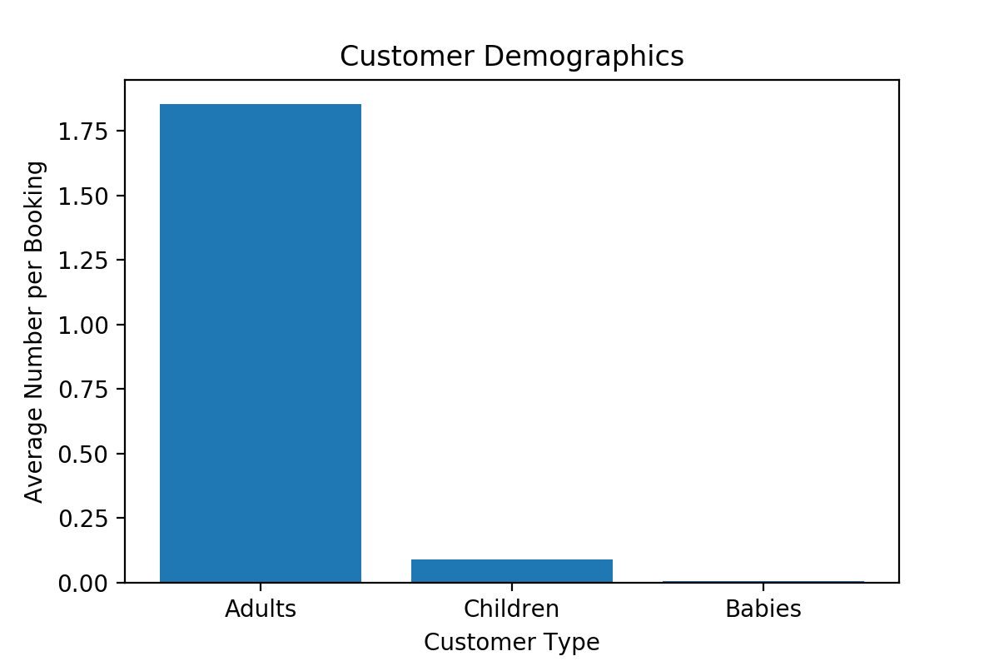

Slide 8
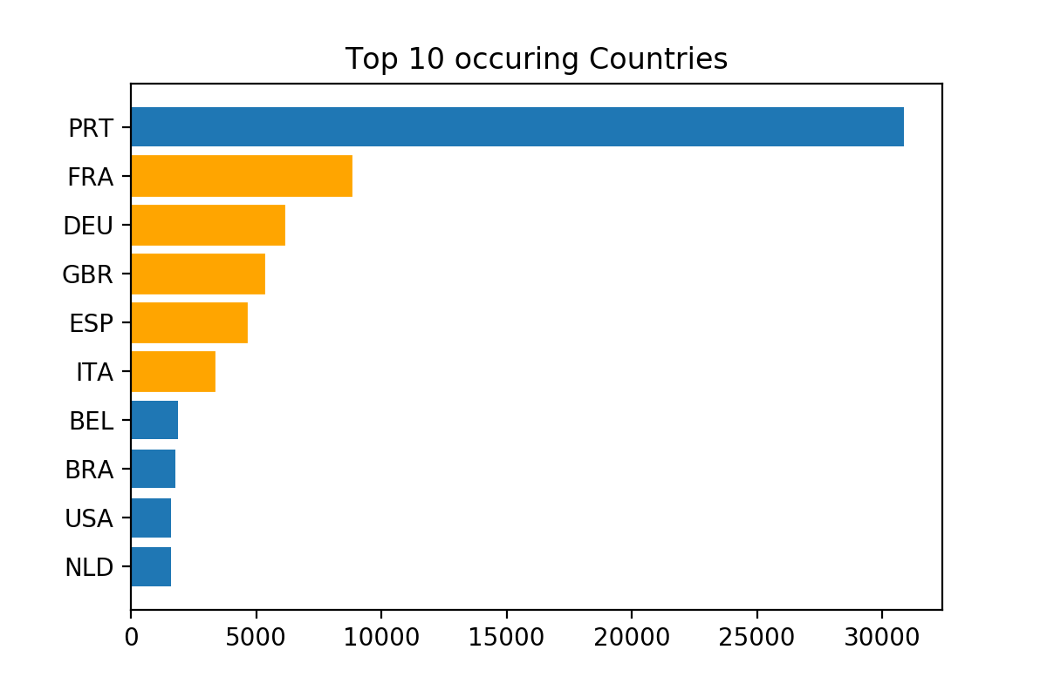

Slide 9
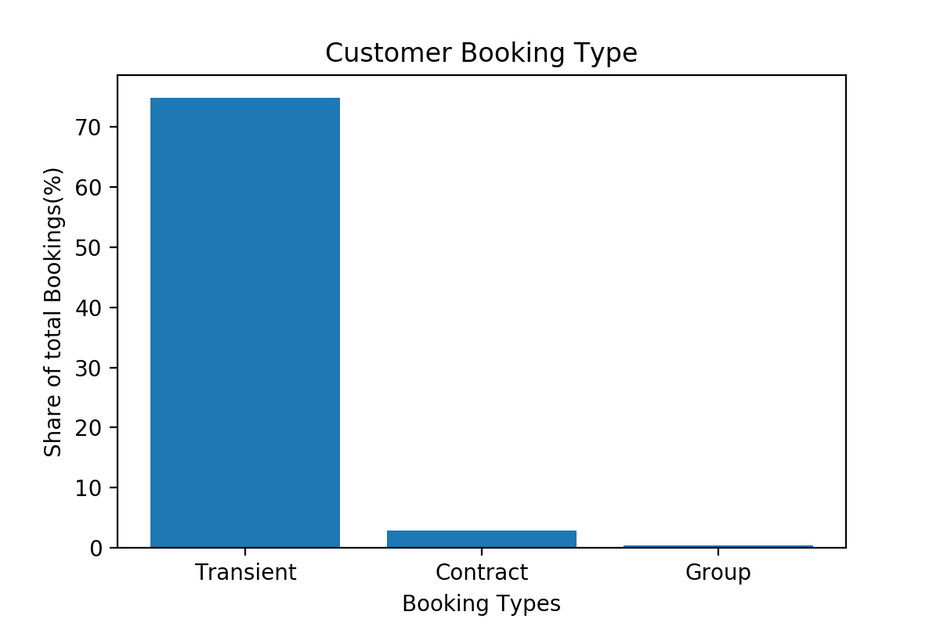

Slide 10
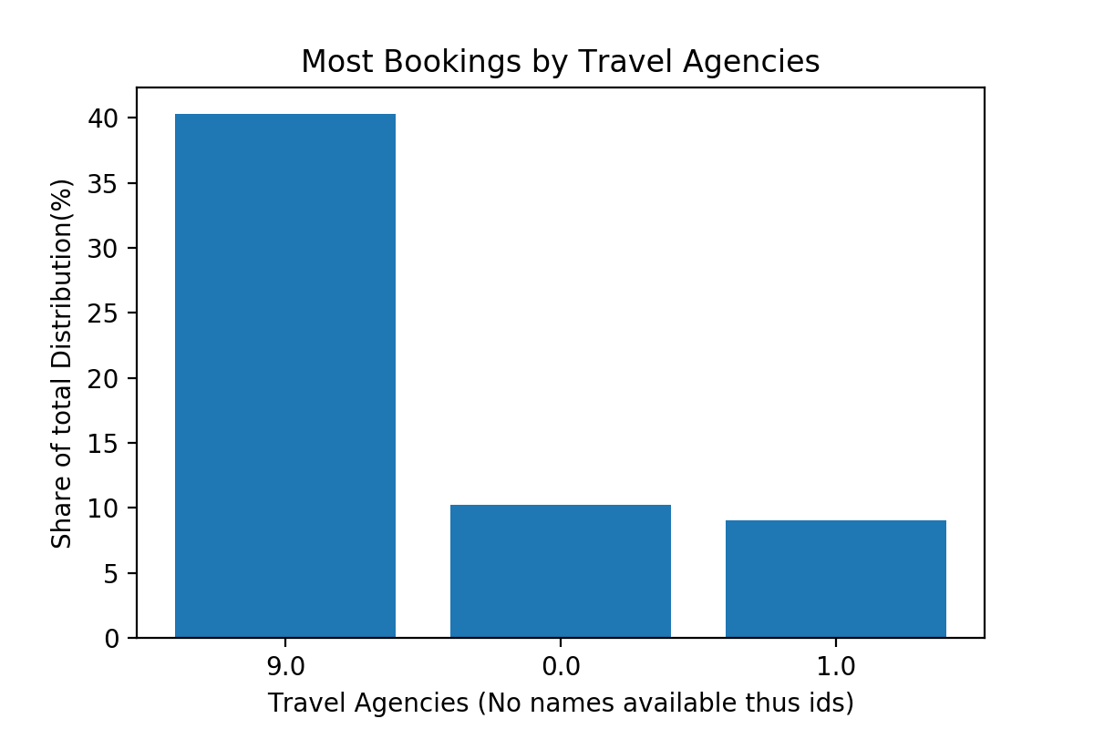

Slide 11
Recommendations Tailoring
Recommending a tailoring towards adults that are on-the-move and need a quick stay-in
Lots of (smaller) rooms that are spontaneously ready and available
Quick check ins, check outs and reception
Seamless booking process
Offer lots of cultural/sociological content for the big European countries, e.g. special meals, events, hire personal such that there is at least one that speaks the specific language, …
Close a special deal with Agency “9” as nearly half of the customers use them to book → such that the Agency also promotes this hotel for more potential guests that book for them selves

Slide 12

Cancellation Rate
Identifying the potential reasons for increasing cancellation rates to counteract.
Avg Industry: 39,2%
Current Cancellation Rate: 41,97% (+2,77%)
Potential Reasons:
Too long waiting time until reservation confirmation
Low number of reoccurring guests
Rate of wrong room assignments too high

Slide 13
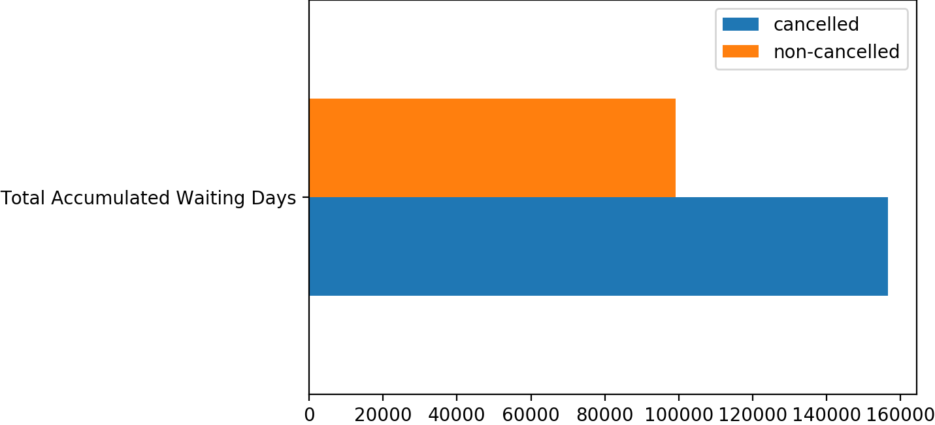

Slide 14
Wrong Room Assignments:
8,94%
Reoccurring Guests: (Industry Standard according to Deloitte Study)
~8%
Current Reoccurring Guests:
2,5%(-5,5%)
Optimize Room Allocation and availability
Optimize Reservation Processes (e.g. implementing a RPA to be more streamlined) to decrease waiting time
Invest in Marketing and offer special deals for past customers

Slide 15
Average Daily Rates
= Sum of all lodging transaction / total staying nights
Which is the optimal staying length that yields the highest transaction returns?
→ Strictly Promote this time frame and try to maximize bookings made in that range

Slide 16
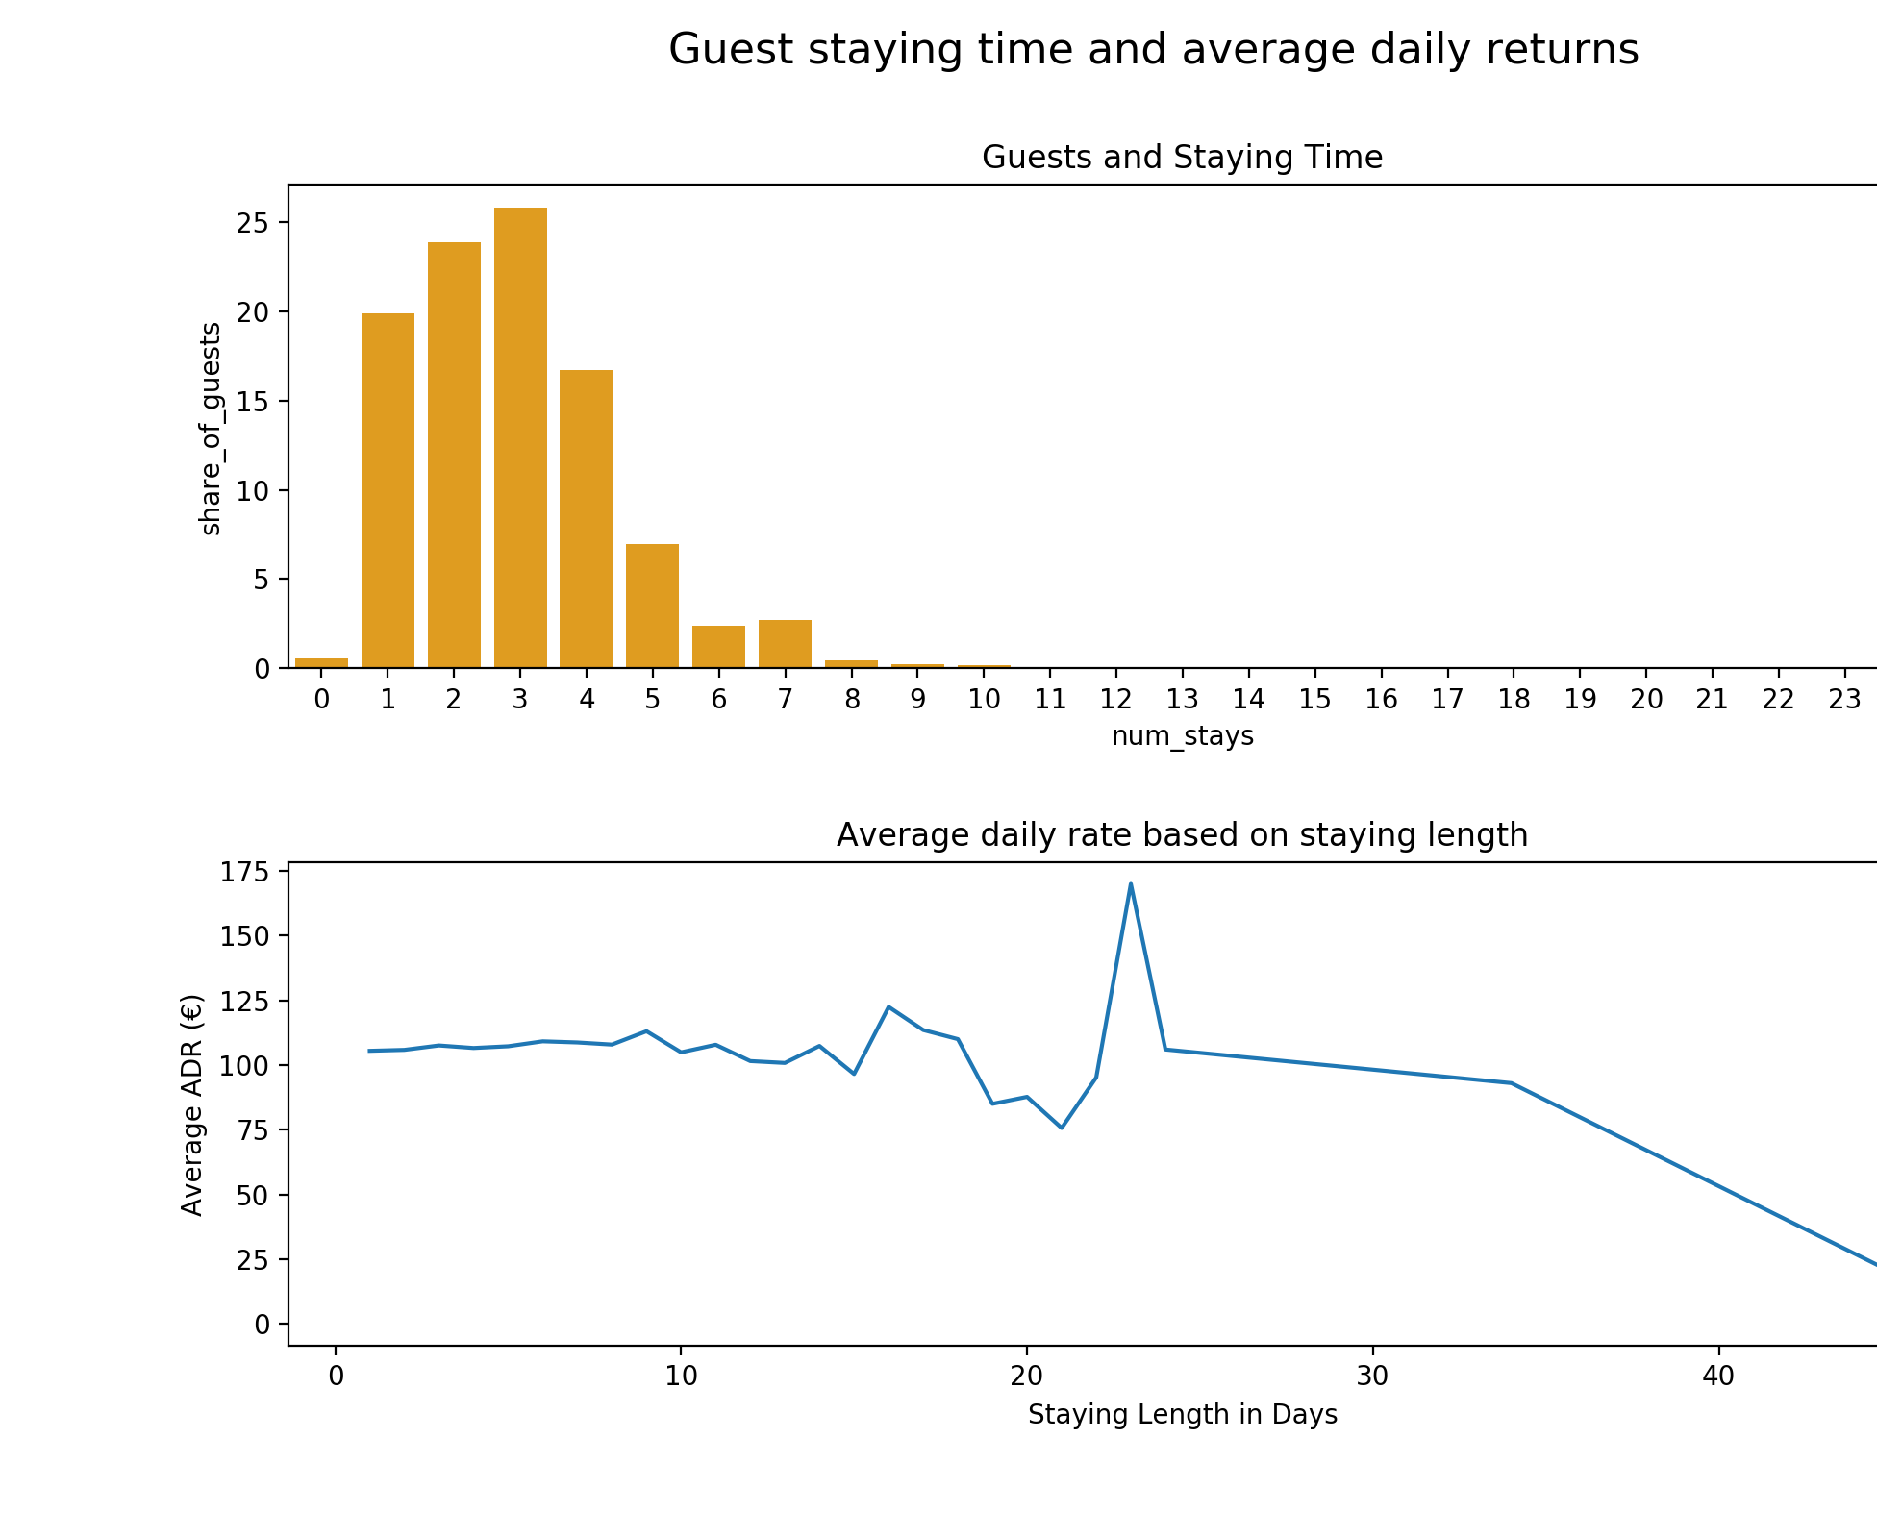
Even though the Average Daily Rates in the 15-30s zone has a slightly higher value,
The actual amount of bookings made in that range is so small that it can be overlooked
Since the length of 1-4 days compensates for 85% of the customers and the rates remaining roughly the same for this particular range → optimal booking range
This also confirms to the tailoring towards transient travelers.

Slide 17
Recommended next steps
Service and content tailoring to the “average customer”
Special deals with most prominent Travel Agency
Decrease cancellation rates by attacking the potential reasons
Optimizing experience for shorter stays to maximize average returns

